Slide 1
AI Driven Traffic Signal Optimization for Emergency Vehicles
PROJECT SUPERVISOR
MS.R.DIVYABHARATHI M.E
ASSISTANT PROFESSOR
DEPARTMENT OF AI&DS
Presented by
ARAVINDAKUMAR S-8208E22ASR012
SUTHARSHANARAM R-8208E22ASR059

Slide 2
Motivation
Why Was This Project Chosen
Emergency vehicles face delays due to heavy traffic.
Faster response times can improve public safety.
Existing traffic systems do not prioritize emergency vehicles effectively.
Smart city development requires intelligent traffic management.
The Need for the Project
Observed delays in emergency vehicle movement in urban areas.
Analyzed real-world traffic congestion issues.
Studied reports on emergency response inefficiencies.
Reviewed existing traffic management solutions and their limitations.

Slide 3
Problem Identified
The process adopted to identify the problem
Observation – Emergency vehicles often get stuck in traffic, causing delays.
Analysis – Studied reports and real-world cases of delayed emergency response. Existing System Review – Found that current traffic lights don’t prioritize emergency vehicles.
The need to solve it
Faster Emergency Response – Saves lives by reducing ambulance and fire truck delays. Traffic Congestion – Helps clear traffic jams, improving overall road safety.
Smart City Development – Supports future AI-driven traffic management.
How do you manage to solve it
AI-Based Traffic Signals – Detects emergency vehicles and changes lights dynamically. Fastest Route Selection – Uses Modified A* algorithm to find the best path. Traffic Prediction & Control – Uses Deep Q-Learning (DQN) and Graph Neural Networks (GNNs) to manage traffic efficiently.

Slide 4
Base Paper Details
Title of the Paper: Smart Ambulance Traffic Sensing using Artificial Intelligence and Internet of Things
Journal Name: IEEE
Publication Date: 2024
Authors' Names : Gopinathan S, Abishek B, Kathiravan G, Roshith P B, Bharath V
1904AS651 - Mini project

Slide 5
Literature Review
S.No | Paper Title | Authors | Technology Used | Key Contribution | Identified Gaps
1 | Smart Ambulance Traffic Sensing using Artificial Intelligence and IoT | Gopinathan S., Abishek B., Kathiravan G., Roshith P. B., Bharath V. | YOLO, CNN, ANN, Audio Detection, Raspberry Pi | Real-time ambulance detection using video and sound, automatic signal control | No route optimization, no learning-based traffic prediction
2 | IoT Based Traffic Management System for Emergency Vehicles | Mohandass M., Maareeswari M., Vimalraj R. | IoT, Sensors, Basic Route Mapping | Tracks emergency vehicle location, controls traffic lights using IoT | No ML/DL models, lacks intelligent routing or adaptive control
3 | CNN-based Emergency Vehicle Detection using Video Feed | Kumar A., Prakash N. | CNN, Camera Feed | Detects ambulances from surveillance footage for traffic management | No signal control or dynamic routing, limited to detection only

Slide 6
Methodology
Emergency detected → Ambulance location tracked via GPS.
YOLO detects ambulance in live camera feeds.
Modified A* algorithm finds the optimal route based on traffic density.
DQL controls signals and turns them green along the ambulance path.
GNN checks traffic ahead and reroutes if necessary.
Traffic signal units receive commands and respond in real time.

Slide 7
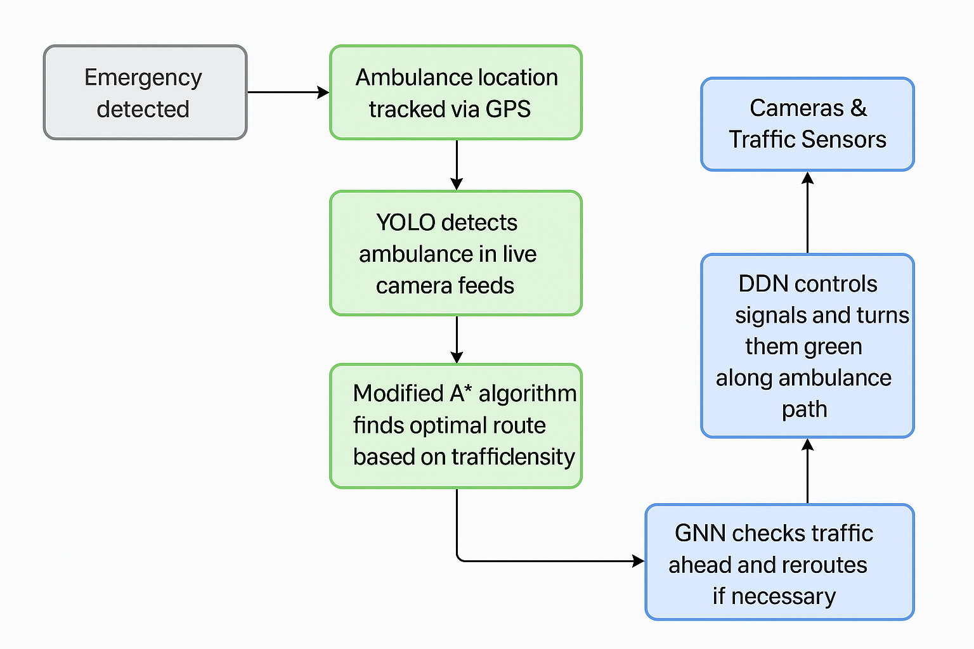
Architecture
DQL

Slide 8
Key Business Objectives
Clear & Measurable Goals – Set specific targets like reducing emergency response time by 30%.
Customer Satisfaction – Ensure faster and safer emergency response, benefiting patients, responders, and the public.
Revenue Growth – Implement a cost-effective AI traffic system that reduces fuel costs and traffic congestion losses.
Competitive Edge – Used for smarter traffic management, making cities more efficient and future-ready.

Slide 9
Tools and Technologies Used
Software:
Python – programming language.
TensorFlow – For building DQN and GNN models.
YOLO – For emergency vehicle detection using camera input.
NetworkX – For implementing Modified A* for pathfinding.
Flask– To build backend and dashboard.
Hardware & IoT Tools:
Raspberry Pi – Mini computer for traffic light control.
Cameras & Sensors – To detect vehicle presence and traffic density.
GPS Modules – To track ambulance location in real-time.
IoT-enabled traffic signals – To communicate with the AI system.

Slide 10
References
Gopinathan S., Abishek B., Kathiravan G., Roshith P. B., Bharath V., “Smart Ambulance Traffic Sensing using Artificial Intelligence and Internet of Things,” 2024 International Conference on Communication, Computing and Internet of Things (IC3IoT), DOI: 10.1109/IC3IoT60841.2024.10550228
Mohandass M., Maareeswari M., Vimalraj R., “IoT Based Traffic Management System for Emergency Vehicles,” IEEE Sensors Journal, 2023.
Nirmaladevi P., Pavithra M., Manoj V., Hariprasath A., Sundar Tharma J.P., “Smart Traffic Management System for Emergency Vehicles Using Deep Learning,” 2024 15th International Conference on Computing Communication and Networking Technologies (ICCCNT), DOI: 10.1109/ICCCNT61001.2024.10724936

